Slide 1
Chapter 6: Static Routing
Routing and Switching Essentials
Notes:
Cisco Networking Academy program
Routing Protocols
Chapter 6: Static Routing

Slide 2
Chapter 6
6.1 Static Routing Implementation
6.2 Configure Static and Default Routes
6.3 Review of CIDR and VLSM
6.4 Configure Summary and Floating Static Routes
6.5 Troubleshoot Static and Default Route Issues
6.6 Summary
Notes:
Chapter 6

Slide 3
Chapter 6: Objectives
Explain the advantages and disadvantages of static routing.
Explain the purpose of different types of static routes.
Configure IPv4 and IPv6 static routes by specifying a next-hop address.
Configure an IPv4 and IPv6 default routes.
Explain the use of legacy classful addressing in network implementation.
Explain the purpose of CIDR in replacing classful addressing.

Slide 4
Chapter 6: Objectives (cont.)
Design and implement a hierarchical addressing scheme.
Configure an IPv4 and IPv6 summary network address to reduce the number of routing table updates.
Configure a floating static route to provide a backup connection.
Explain how a router processes packets when a static route is configured.
Troubleshoot common static and default route configuration issues.

Slide 5
Static Routing Reach Remote Networks
A router can learn about remote networks in one of two ways:
Manually - Remote networks are manually entered into the route table using static routes.
Dynamically - Remote routes are automatically learned using a dynamic routing protocol.
Notes:
6.1.1.1 Reach Remote Networks

Slide 6
Static Routing Why Use Static Routing?
Static routing provides some advantages over dynamic routing, including:
Static routes are not advertised over the network, resulting in better security.
Static routes use less bandwidth than dynamic routing protocols, no CPU cycles are used to calculate and communicate routes.
The path a static route uses to send data is known.
Notes:
6.1.1.2 Why Use Static Routing?

Slide 7
Static Routing Why Use Static Routing? (cont.)
Static routing has the following disadvantages:
Initial configuration and maintenance is time-consuming.
Configuration is error-prone, especially in large networks.
Administrator intervention is required to maintain changing route information.
Does not scale well with growing networks; maintenance becomes cumbersome.
Requires complete knowledge of the whole network for proper implementation.
Notes:
6.1.1.2 Why Use Static Routing?

Slide 8
Static Routing When to Use Static Routes
Static routing has three primary uses:
Providing ease of routing table maintenance in smaller networks that are not expected to grow significantly.
Routing to and from stub networks. A stub network is a network accessed by a single route, and the router has no other neighbors.
Using a single default route to represent a path to any network that does not have a more specific match with another route in the routing table. Default routes are used to send traffic to any destination beyond the next upstream router.
Notes:
6.1.1.3 When to Use Static Routes

Slide 9
Types of Static Routes Static Route Applications
Static Routes are often used to:
Connect to a specific network.
Provide a Gateway of Last Resort for a stub network.
Reduce the number of routes advertised by summarizing several contiguous networks as one static route.
Create a backup route in case a primary route link fails.
Notes:
6.1.2.1 Static Route Applications

Slide 10
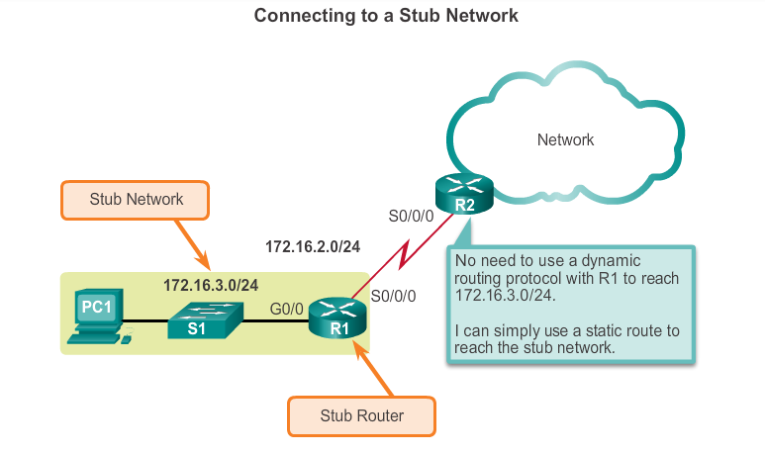
Types of Static Routes Standard Static Route
Notes:
6.1.2.2 Standard Static Route

Slide 11
Types of Static Routes Default Static Route
A default static route is a route that matches all packets.
A default route identifies the gateway IP address to which the router sends all IP packets that it does not have a learned or static route.
A default static route is simply a static route with 0.0.0.0/0 as the destination IPv4 address.
Notes:
6.1.2.3 Default Static Route

Slide 12
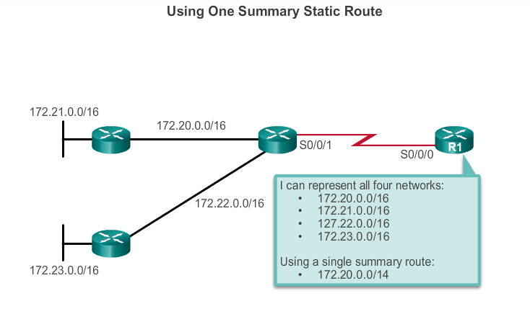
Types of Static Routes Summary Static Route
Notes:
6.1.2.4 Summary Static Route

Slide 13
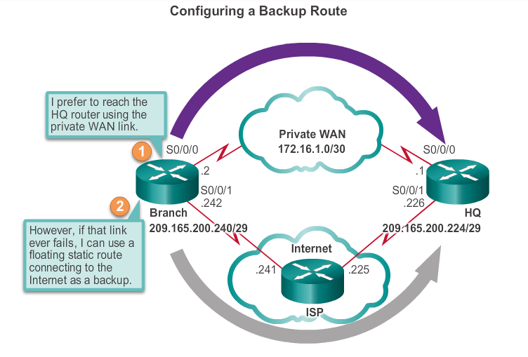
Types of Static Routes Floating Static Route
Floating static routes are static routes that are used to provide a backup path to a primary static or dynamic route, in the event of a link failure.
The floating static route is only used when the primary route is not available.
To accomplish this, the floating static route is configured with a higher administrative distance than the primary route.
Notes:
6.1.2.5 Floating Static Route

Slide 14
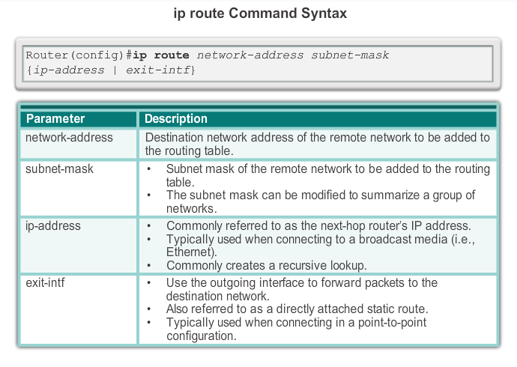
Configure IPv4 Static Routes ip route Command
Notes:
6.2.1.1 ip route Command

Slide 15
Configure IPv4 Static Routes Next-Hop Options
The next hop can be identified by an IP address, exit interface, or both. How the destination is specified creates one of the three following route types:
Next-hop route - Only the next-hop IP address is specified.
Directly connected static route - Only the router exit interface is specified.
Fully specified static route - The next-hop IP address and exit interface are specified.
Notes:
6.2.1.2 Next-Hop Options

Slide 16
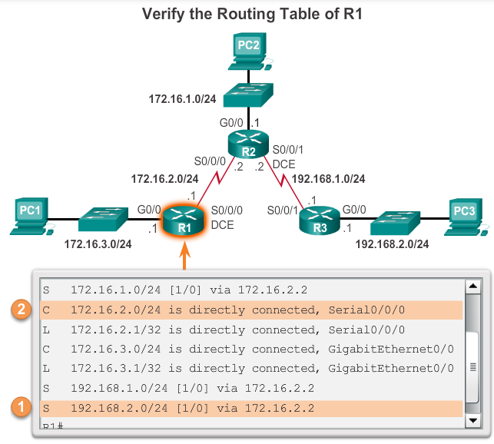
Configure IPv4 Static Routes Configure a Next-Hop Static Route
When a packet is destined for the 192.168.2.0/24 network, R1:
1. Looks for a match in the routing table and finds that it has to forward the packets to the next-hop IPv4 address 172.16.2.2.
2. R1 must now determine how to reach 172.16.2.2; therefore, it searches a second time for a 172.16.2.2 match.
Notes:
6.2.1.3 Configure a Next-Hop Static Route

Slide 17
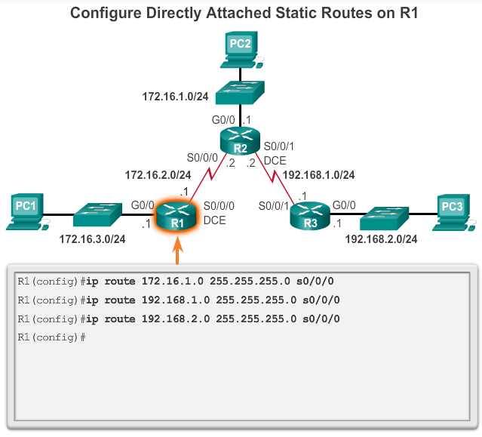
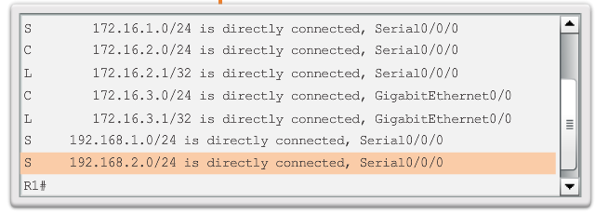
Configure IPv4 Static Routes Configure Directly Connected Static Route
Notes:
6.2.1.4 Configure a Directly Connected Static Route

Slide 18
Configure IPv4 Static Routes Configure a Fully Specified Static Route
In a fully specified static route:
Both the output interface and the next-hop IP address are specified.
This is another type of static route that is used in older IOSs, prior to CEF.
This form of static route is used when the output interface is a multi-access interface and it is necessary to explicitly identify the next hop.
The next hop must be directly connected to the specified exit interface.
Notes:
6.2.1.5 Configure a Fully Specified Static Route

Slide 19
Configure IPv4 Static Routes Verify a Static Route
Along with ping and traceroute, useful commands to verify static routes include:
show ip route
show ip route static
show ip route network
Notes:
6.2.1.6 Verify a Static Route

Slide 20
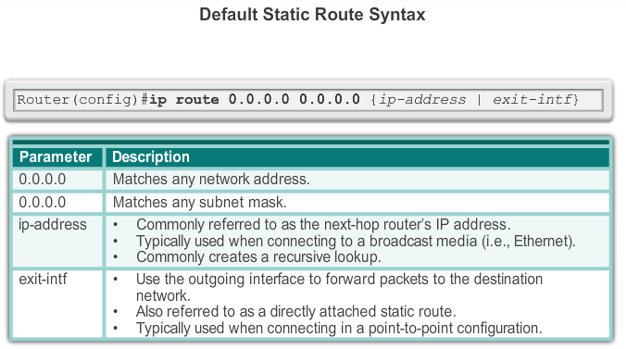
Configure IPv4 Default Routes Default Static Route
Notes:
6.2.2.1 Default Static Route

Slide 21
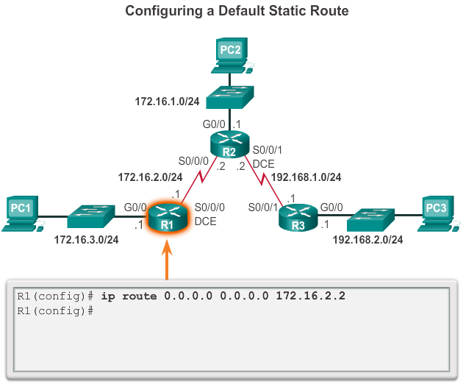
Configure IPv4 Default Routes Configure a Default Static Route
Notes:
6.2.2.2 Configure a Default Static Route

Slide 22
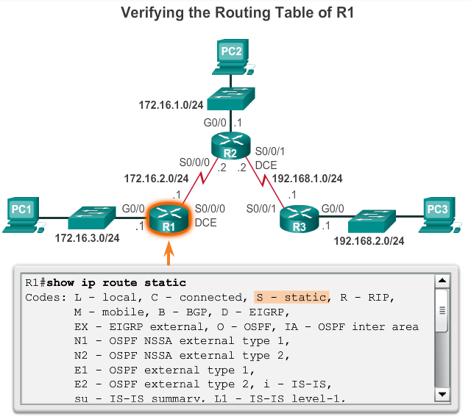
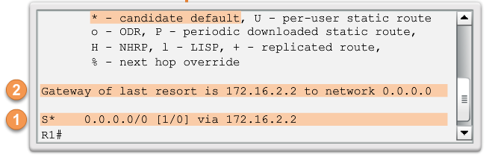
Configure IPv4 Default Routes Verify a Default Static Route
Notes:
6.2.2.3 Verify a Default Static Route

Slide 23

Configure IPv6 Static Routes The ipv6 route Command
Most of parameters are identical to the IPv4 version of the command. IPv6 static routes can also be implemented as:
Standard IPv6 static route
Default IPv6 static route
Summary IPv6 static route
Floating IPv6 static route
Notes:
6.2.3.1 The ipv6 route Command

Slide 24
Configure IPv6 Static Routes Next-Hop Options
The next hop can be identified by an IPv6 address, exit interface, or both. How the destination is specified creates one of three route types:
Next-hop IPv6 route - Only the next-hop IPv6 address is specified.
Directly connected static IPv6 route - Only the router exit interface is specified.
Fully specified static IPv6 route - The next-hop IPv6 address and exit interface are specified.
Notes:
6.2.3.2 Next-Hop Options

Slide 25
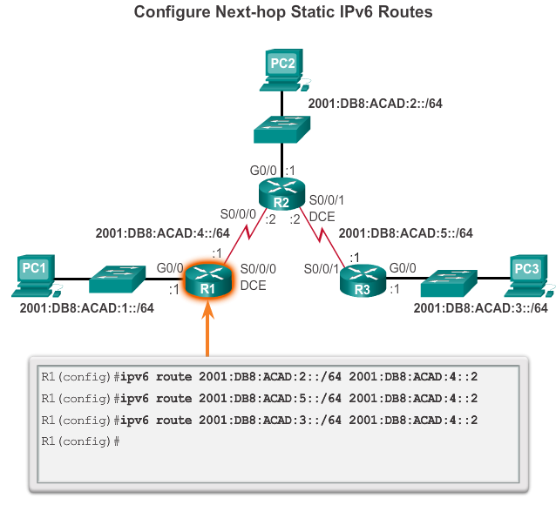
Configure IPv6 Static Routes Configure a Next-Hop Static IPv6 Route
Notes:
6.2.3.3 Configure a Next-Hop Static IPv6 Route

Slide 26
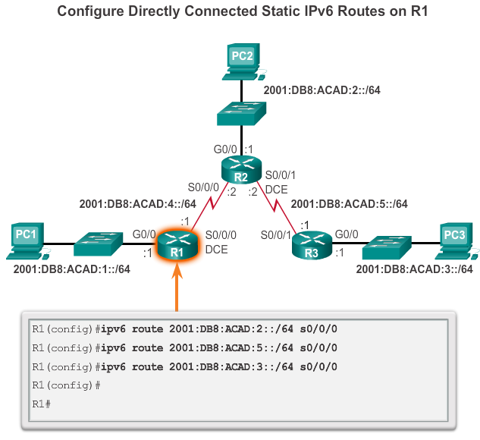
Configure IPv6 Static Routes Configure Directly Connected Static IPv6 Route
Notes:
6.2.3.4 Configure a Directly Connected Static IPv6 Route

Slide 27
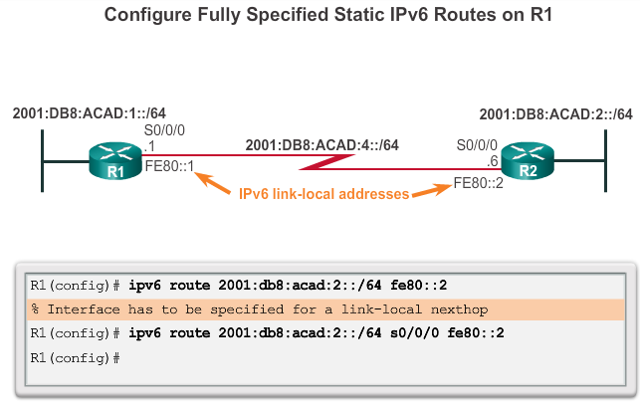
Configure IPv6 Static Routes Configure Fully Specified Static IPv6 Route
Notes:
6.2.3.5 Configure a Fully Specified Static IPv6 Route

Slide 28
Configure IPv6 Static Routes Verify IPv6 Static Routes
Along with ping and traceroute, useful commands to verify static routes include:
show ipv6 route
show ipv6 route static
show ipv6 route network
Notes:
6.2.3.6 Verify IPv6 Static Routes

Slide 29
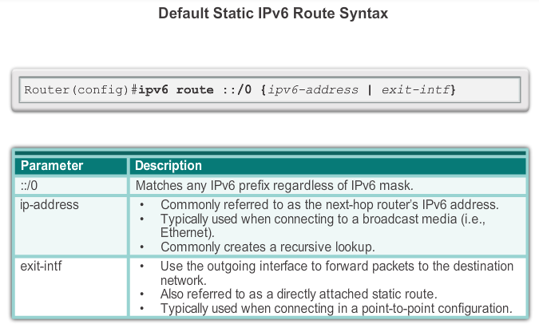
Configure IPv6 Default Routes Default Static IPv6 Route
Notes:
6.2.4.1 Default Static IPv6 Route

Slide 30
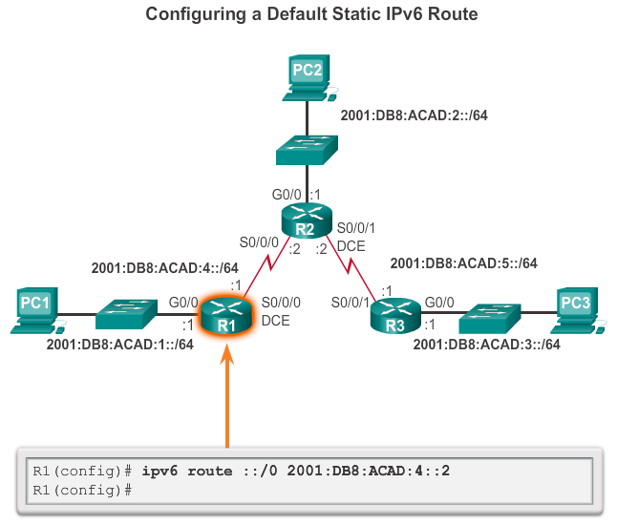
Configure IPv6 Default Routes Configure a Default Static IPv6 Route
Notes:
6.2.4.2 Configure a Default Static IPv6 Route

Slide 31
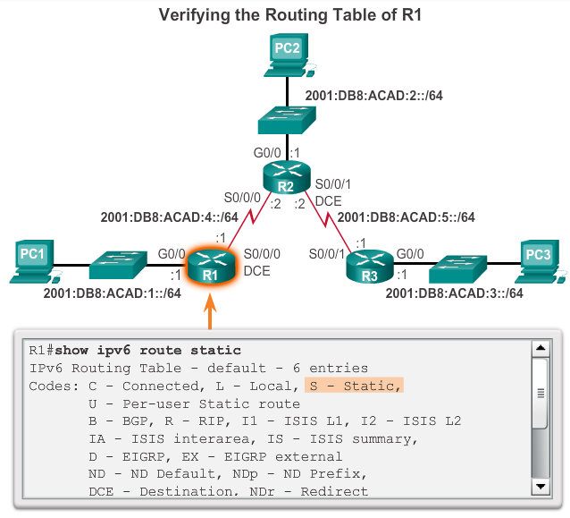
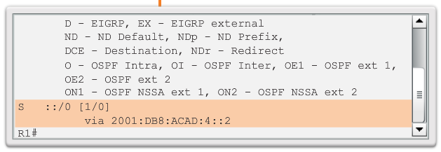
Configure IPv6 Default Routes Verify a Default Static Route
Notes:
6.2.4.3 Verify a Default Static Route

Slide 32
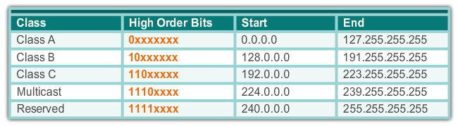
Classful Addressing Classful Network Addressing
Notes:
6.3.1.1 Classful Network Addressing

Slide 33



Classful Addressing Classful Subnet Masks
Class A
Class B
Class C
Notes:
6.3.1.2 Classful Subnet Masks

Slide 34
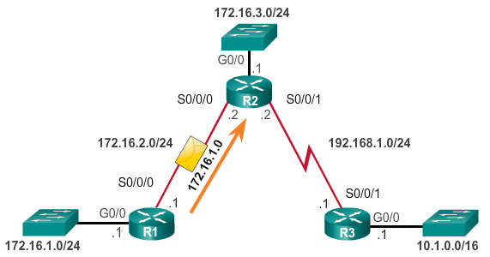
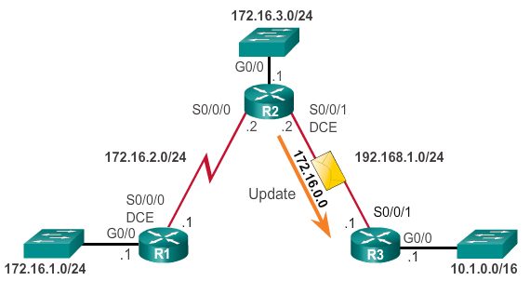
Classful Addressing Classful Routing Protocol Example
Notes:
6.3.1.3 Classful Routing Protocol Example

Slide 35
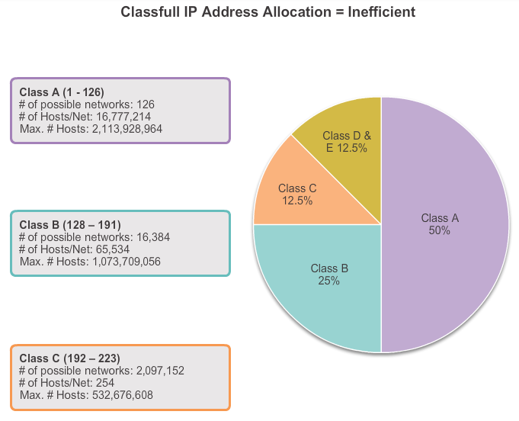
Classful Addressing Classful Addressing Waste
Notes:
6.3.1.4 Classful Addressing Waste

Slide 36
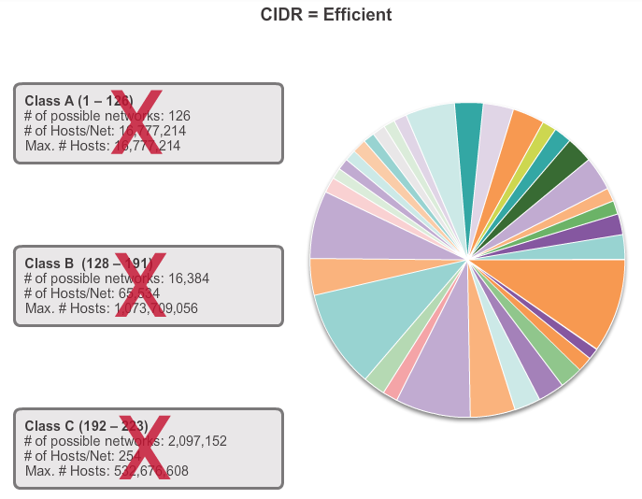
CIDR Classless Inter-Domain Routing
Notes:
6.3.2.1 Classless Inter-Domain Routing

Slide 37
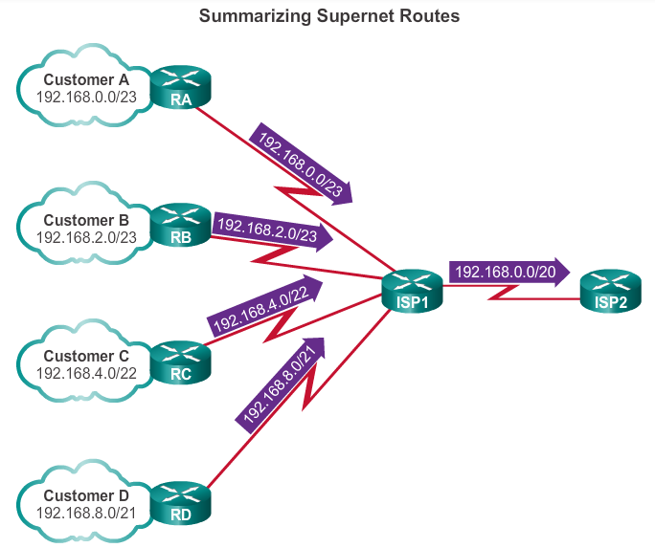
CIDR CIDR and Route Summarization
Notes:
6.3.2.2 CIDR and Route Summarization

Slide 38
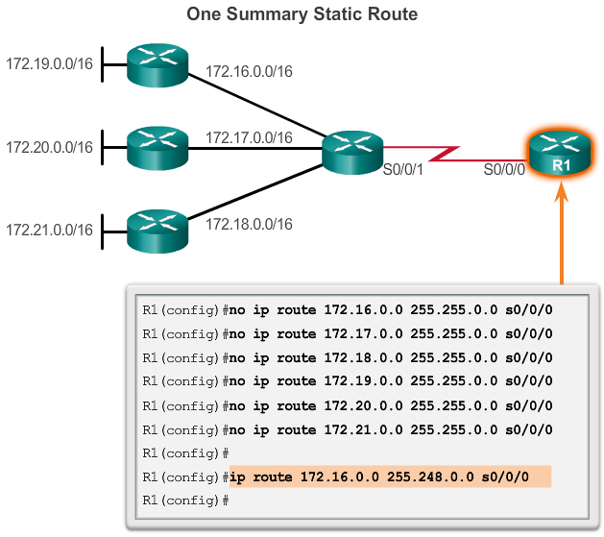
CIDR Static Routing CIDR Example
Notes:
6.3.2.3 Static Routing CIDR Example

Slide 39
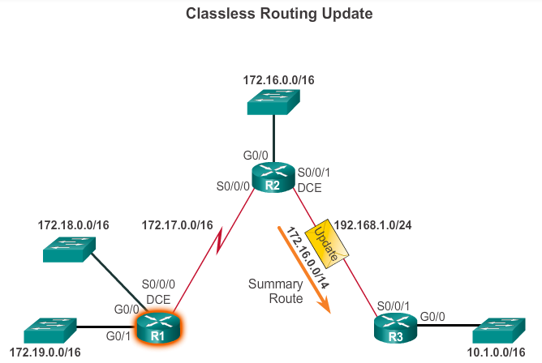
CIDR Classless Routing Protocol Example
Notes:
6.3.2.4 Classless Routing Protocol Example

Slide 40
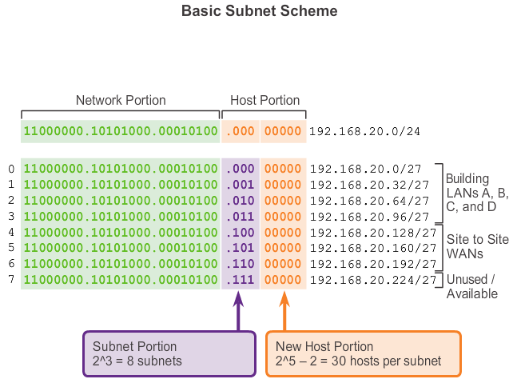
VLSM Fixed Length Subnet Masking
Notes:
6.3.3.1 Fixed-Length Subnet Masking

Slide 41
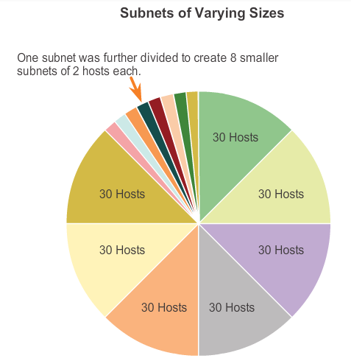
VLSM Variable Length Subnet Masking
Notes:
6.3.3.2 Variable-Length Subnet Masking

Slide 42
VLSM VLSM in Action
VLSM allows the use of different masks for each subnet:
After a network address is subnetted, those subnets can be further subnetted.
VLSM is simply subnetting a subnet. VLSM can be thought of as sub-subnetting.
Individual host addresses are assigned from the addresses of "sub-subnets".
Notes:
6.3.3.3 VLSM in Action

Slide 43
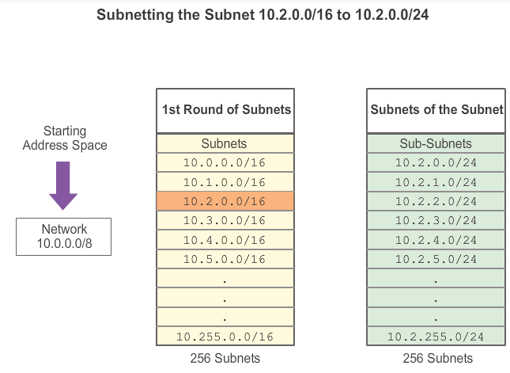
VLSM Subnetting Subnets
Notes:
6.3.3.4 Subnetting Subnets

Slide 44
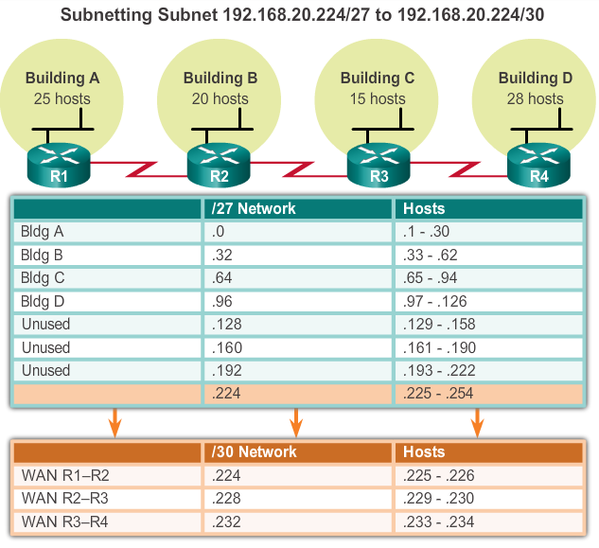
VLSM VLSM Example
Notes:
6.3.3.5 VLS

Slide 45
Configure IPv4 Summary Routes Route Summarization
Route summarization, also known as route aggregation, is the process of advertising a contiguous set of addresses as a single address with a less-specific, shorter subnet mask:
CIDR is a form of route summarization and is synonymous with the term supernetting.
CIDR ignores the limitation of classful boundaries, and allows summarization with masks that are smaller than that of the default classful mask.
This type of summarization helps reduce the number of entries in routing updates and lowers the number of entries in local routing tables.
Notes:
6.4.1.1 Route Summarization

Slide 46
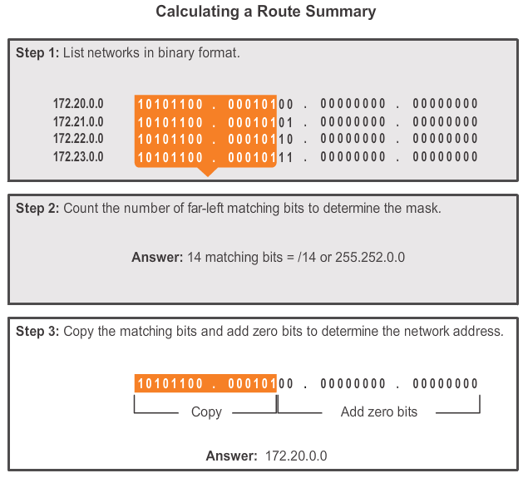
Configure IPv4 Summary Routes Calculate a Summary Route
Notes:
6.4.1.2 Calculate a Summary Route

Slide 47
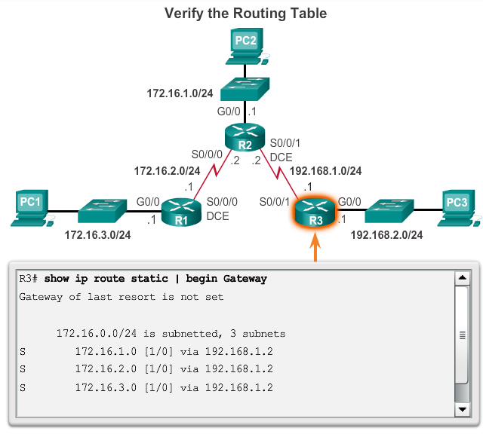
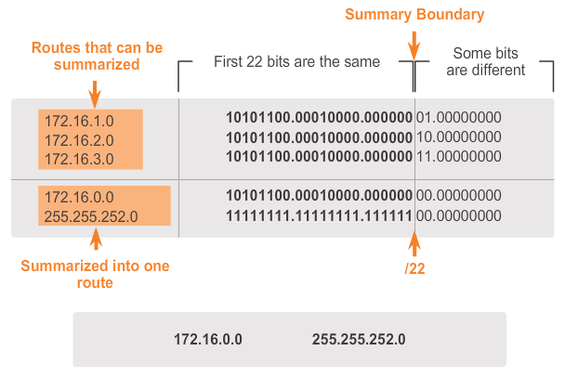
Configure IPv4 Summary Routes Summary Static Route Example
Notes:
6.4.1.3 Summary Static Route Example

Slide 48
Configure IPv6 Summary Routes Summarize IPv6 Network Addresses
Aside from the fact that IPv6 addresses are 128 bits long and written in hexadecimal, summarizing IPv6 addresses is actually similar to the summarization of IPv4 addresses. It just requires a few extra steps due to the abbreviated IPv6 addresses and hex conversion.
Multiple static IPv6 routes can be summarized into a single static IPv6 route if:
The destination networks are contiguous and can be summarized into a single network address.
The multiple static routes all use the same exit interface or next-hop IPv6 address.
Notes:
6.4.2.1 Summarize IPv6 Network Addresses

Slide 49
Configure IPv6 Summary Routes Calculate IPv6 Network Addresses
There are seven steps to summarize IPv6 networks into a single IPv6 prefix:
Step 1. List the network addresses (prefixes) and identify the part where the addresses differ.
Step 2. Expand the IPv6 if it is abbreviated.
Step 3. Convert the differing section from hex to binary.
Step 4. Count the number of far left matching bits to determine the prefix-length for the summary route.
Step 5. Copy the matching bits and then add zero bits to determine the summarized network address (prefix).
Step 6. Convert the binary section back to hex.
Step 7. Append the prefix of the summary route (result of Step 4).
Notes:
6.4.2.2 Calculate IPv6 Network Addresses

Slide 50
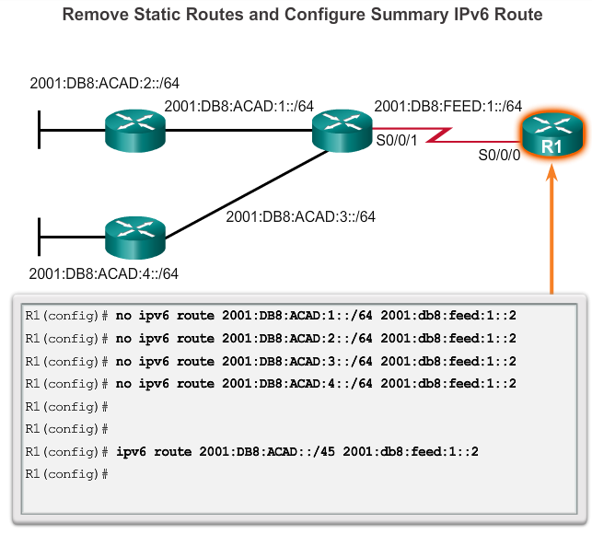
Configure IPv6 Summary Routes Configure an IPv6 Summary Address
Notes:
6.4.2.3 Configure an IPv6 Summary Address

Slide 51
Configure Floating Static Routes Floating Static Routes
Floating static routes are static routes that have an administrative distance greater than the administrative distance of another static route or dynamic routes:
The administrative distance of a static route can be increased to make the route less desirable than that of another static route or a route learned through a dynamic routing protocol.
In this way, the static route “floats” and is not used when the route with the better administrative distance is active.
However, if the preferred route is lost, the floating static route can take over, and traffic can be sent through this alternate route.
Notes:
6.4.3.1 Floating Static Routes

Slide 52
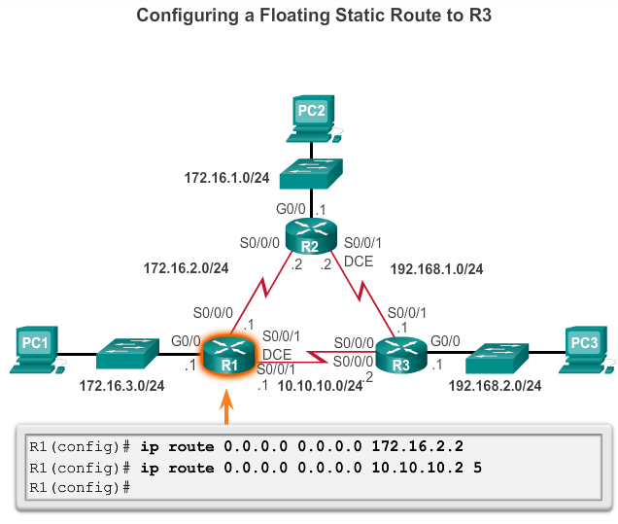
Configure Floating Static Routes Configure a Floating Static Route
Notes:
6.4.3.2 Configure a Floating Static Route

Slide 53
Configure Floating Static Routes Test the Floating Static Route
To test a floating static route:
Use a show ip route command to verify that the routing table is using the default static route.
Use a traceroute command to follow the traffic flow out the primary route.
Disconnect the primary link or shutdown the primary exit interface.
Use a show ip route command to verify that the routing table is using the floating static route.
Use a traceroute command to follow the traffic flow out the backup route.
Notes:
6.4.3.3 Test the Floating Static Route

Slide 54
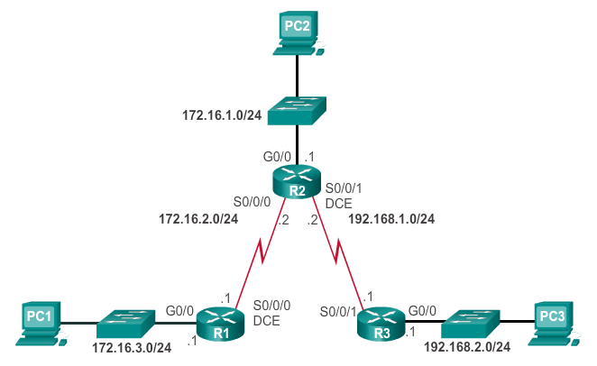
Troubleshoot Static and Default Route Issues Static Routes and Packet Forwarding
Notes:
6.5.2.1 Troubleshoot a Missing Route

Slide 55
Troubleshoot IPv4 Static and Default Route Configuration Troubleshoot a Missing Route
Common IOS troubleshooting commands include:
ping
traceroute
show ip route
show ip interface brief
show cdp neighbors detail
Notes:
6.5.2.1 Troubleshoot a Missing Route

Slide 56
Troubleshoot IPv4 Static and Default Route Configuration Solve a Connectivity Problem
Finding a missing (or misconfigured) route is a relatively straightforward process, if the right tools are used in a methodical manner.
Use the ping command to confirm the destination can’t be reached.
A traceroute would also reveal what is the closest router (or hop) that fails to respond as expected. In this case, the router would then send an Internet Control Message Protocol (ICMP) destination unreachable message back to the source.
The next step is to investigate the routing table. Look for missing or misconfigured routes.
Incorrect static routes are a common cause of routing problems.
Notes:
6.5.2.2 Solve a Connectivity Problem

Slide 57
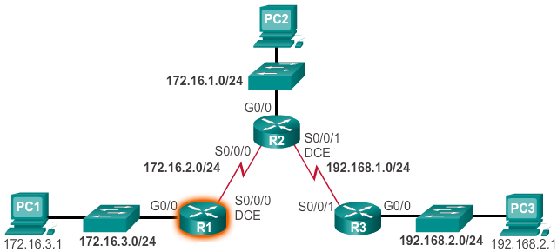
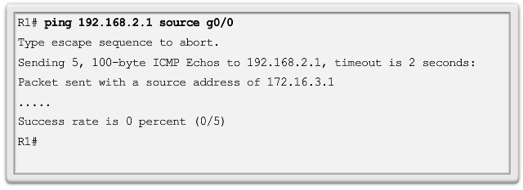
Troubleshoot IPv4 Static and Default Route Configuration Solve a Connectivity Problem (cont.)
Notes:
6.5.2.2 Solve a Connectivity Problem

Slide 58
Troubleshoot IPv4 Static and Default Route Configuration Solve a Connectivity Problem (cont.)
Refer to the topology shown in the previous slide.
The user at PC1 reports that he cannot access resources on the R3 LAN.
This can be confirmed by pinging the LAN interface of R3 using the LAN interface of R1 as the source (see Figure 1). The results show that there is no connectivity between these LANs.
A traceroute would reveal that R2 is not responding as expected.
For some reason, R2 forwards the traceroute back to R1. R1 returns it to R2.
This loop would continue until the time to live (TTL) value decrements to zero, in which case, the router would then send an Internet Control Message Protocol (ICMP) destination unreachable message to R1.
Notes:
6.5.2.2 Solve a Connectivity Problem

Slide 59
Troubleshoot IPv4 Static and Default Route Configuration Solve a Connectivity Problem (cont.)
The next step is to investigate the routing table of R2, because it is the router displaying a strange forwarding pattern.
The routing table would reveal that the 192.168.2.0/24 network is configured incorrectly.
A static route to the 192.168.2.0/24 network has been configured using the next-hop address 172.16.2.1.
Using the configured next-hop address, packets destined for the 192.168.2.0/24 network are sent back to R1.
Based on the topology, the 192.168.2.0/24 network is connected to R3, not R1. Therefore, the static route to the 192.168.2.0/24 network on R2 must use next-hop 192.168.1.1, not 172.16.2.1.
Notes:
6.5.2.2 Solve a Connectivity Problem

Slide 60
Chapter 6: Summary
Static routes can be configured with a next-hop IP address, which is commonly the IP address of the next-hop router.
When a next-hop IP address is used, the routing table process must resolve this address to an exit interface.
On point-to-point serial links, it is usually more efficient to configure the static route with an exit interface.
On multi-access networks, such as Ethernet, both a next-hop IP address and an exit interface can be configured on the static route.
Static routes have a default administrative distance of "1".
Notes:
Chapter 6 Summary

Slide 61
Chapter 6: Summary (cont.)
A static route is only entered in the routing table if the next-hop IP address can be resolved through an exit interface.
Whether the static route is configured with a next-hop IP address or exit interface, if the exit interface that is used to forward that packet is not in the routing table, the static route is not included in the routing table.
In many cases, several static routes can be configured as a single summary route.
Notes:
Chapter 6 Summary

Slide 62
Chapter 6: Summary (cont.)
The ultimate summary route is a default route, configured with a 0.0.0.0 network address and a 0.0.0.0 subnet mask.
If there is not a more specific match in the routing table, the routing table uses the default route to forward the packet to another router.
A floating static route can be configured to back up a main link by manipulating its administrative value.
Notes:
Chapter 6 Summary

Slide 63


